Slide 1
ASP.NET MVC 3
Tips and Tricks
Scott Mitchell
mitchell@fuzzylogicinc.net
http://fuzzylogicinc.net/classes/sdsig.zip

Slide 2
Contact Info
Scott Mitchell
Email: mitchell@fuzzylogicinc.net
Blog: http://ScottOnWriting.NET
Twitter: @ScottOnWriting
Download the slides and code from:
http://fuzzylogicinc.net/classes/sdsig.zip

Slide 3
ASP.NET MVC Training…
A full day of ASP.NET MVC 3 training!
  Saturday, September 24th
  Two sessions:
    Getting Started with ASP.NET MVC 3 and Razor
    Building Real-World Web Applications with ASP.NET MVC 3
Sign up at http://fuzzylogicinc.net/InDepth

Slide 4
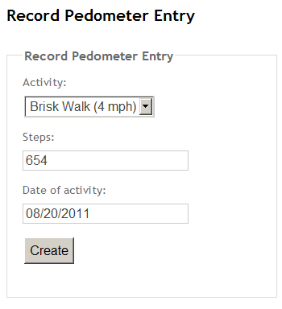
Sample Code
A simple online pedometer tracker
  Users create “entries”
  by supplying:
    The activity date
    The activity performed
    The number of steps
  Calorie expenditure computed automatically

Slide 5
ASP.NET MVC is a user interface framework.
  The Models used by an ASP.NET MVC application are the Presentation Models.
  Typically one Presentation Model class per view.
A Presentation Model represents the display on screen and captures the user input.
  Will be defined by classes in the OnlineScale.Web project’s Models folder.

Slide 6
Mapping Between Models
TIP: Use AutoMapper to map objects between models.
  Open source, free
  Download using NuGet or from http://automapper.codeplex.com/

Slide 7
Can create display or editing interfaces for the Presentation Model using templates.
  Html.Display(“propertyName”)
  Html.DisplayFor(m => m.Property)
  Html.DisplayForModel()
  Html.Editor(“propertyName”)
  Html.EditorFor(m => m.Property)
  Html.EditorForModel()
TIP: Prefer the strongly-typed methods over the loosely-typed ones. In short, avoid using Html.Display or Html.Editor.

Slide 8
There are a number of built-in templates, including:
Template | Description
Boolean | Displays a checkbox for regular Booleans, a drop-down for nullable Booleans.
Decimal | Formats the number showing two digits.
EmailAddress | Renders a hyperlink with a mailto URL.
MultilineText | Uses a textarea element to render a multi-line textbox.
Password | Uses a password textbox.
Url | Renders a hyperlink.

Slide 9
Custom Templates
Steps to create a custom template:
  Create a DisplayTemplates or EditorTemplates folder
    Can be in a particular Views subfolder or in Views\Shared
  Name the template file Type.cshtml, where Type is the data type name or UIHint name you want to create the template for.
  Use the @model directive to specify the incoming data type.

Slide 10
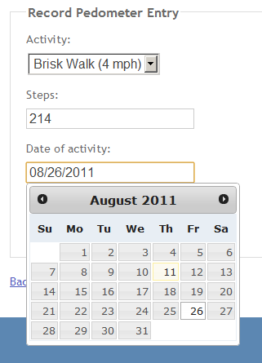
A Custom Editor Template
Can enhance the Activity Date textbox in the Record Entry screen to use the jQuery UI Date Picker…

Slide 11
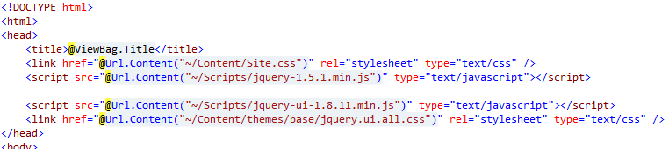
A Custom Editor Template
Steps to implement…
  Reference jQuery UI script and CSS stylesheet in <head> element in _Layout.cshtml.

Slide 12
A Custom Editor Template
Create an editor template (Views\Shared\EditorTemplates\Date.cshtml)
  Have it render a TextBox with a CSS class of text-box single-line date.

Slide 13


Add the DataType attribute to the ActivityDate property in PedometerRecordEntryViewModel
Add the following script to the <head> element in _Layout.cshtml.

Slide 14
When using forms, there are typically two distinct actions:
  GET
    Construct Presentation Model
    Specify view
  POST
    Validate user input
      If valid…
        Map Presentation Model onto Domain Model
        Save/Update/Delete domain model
        Redirect user to success screen
      If invalid…
        Return view

Slide 15
Simplifying POSTs
To simplify POST handling, consider using:
  A custom action result to manage workflow, and
  A separate class to handle “doing the work” when the model state is valid
      Map Presentation Model onto Domain Model
      Save/Update/Delete domain model
See Jimmy Bogard’s article Cleaning up POSTs in ASP.NET MVC for more on this pattern…

Slide 16

Simplifying POSTs
Steps to implement:
  Create an IFormHandler<TModel> interface.
    Represents the work to be done on the Presentation Model to process the form

Slide 17
Simplifying POSTs
Create a class named PedometerRecordEntryViewModelFormHandler to process the form for the RecordEntry action
  Implements IFormHandler<PedometerRecordEntryViewModelForm>
  The handler class does the grunt work – namely, it creates the new Entry Domain Model object and persists it via the Pedometer repository class…

Slide 18
Simplifying POSTs
Create the FormActionResult<TModel> class, which:
  Determines if the model state is valid
  If so, calls the Handle method and performs the “success” action
    Typically a redirect to a success screen…
  If not, runs the “failure” action
    Typically returning the view…

Slide 19
Simplifying POSTs
Finally, update the RecordEntry action to use FormActionResult
  Specify the success and failure actions
  Specify the IFormHandler to process the form

Slide 20
Custom ActionFilters
ActionFilters can be used to…
  Handle orthogonal concerns, such as logging
  Implement conventions to streamline your controller
    Ex: Use an ActionFilter to fill empty IEnumerable<SelectListItem>s in the Presentation Model…

Slide 21
Using an ActionFilter to Populate View Data
Can use a custom ActionFilter to inject data into the Presentation Model
  Useful for populating lookup information for drop-downs
This pattern is explained by Wesley McClure
  See http://goo.gl/k1nJq

Slide 22
Using an ActionFilter to Populate View Data
Steps to implements:
  Create an abstract ActionFilter that can inject any value into any Presentation Model property

Slide 23
Create a concrete class for each Presentation Model that needs an injected value.
  Specify the property to inject into
  Specify the data to inject
See the InjectActivitiesAttribute class…
Decorate the applicable controller actions
  E.g., both the GET and POST RecordEntry actions.

Slide 24

Questions?
http://fuzzylogicinc.net/classes/sdsig.zip

